Slide 1

Database system architecture
Chapter 2

Slide 2
What will you learn ?
Features of Current database applications
Hot topics in database field
Database system architecture
  From DBMS
  From end user
The Database Administrator
DBMS
ANSI/SPARC Architecture

Slide 3
1 features of Current database applications
Integration of the DBMS into the Web environment
Treat the Web as a database application platform
Different integration tools, including CGI(Common Gateway Interface), Java, scripting languages, Active Server pages, and Oracle’s Universal data Server

Slide 4
2 Hot topics in database field
Data Warehouse is a subject-oriented, integrated, time-variant, and non-volatile collection of data in support of management’s decision-making process
Store decision-support data (e.g. customers, products, and sales) rather than application-oriented data (e.g. customer invoicing, stock control and product sales)
Data is not updated in real-time, and usually added as an addition rather than a replacement

Slide 5
OLAP i.e. Online Analytical Processing is the dynamic synthesis, analysis, and consolidation of large volumes of multi-dimensional data, e.g. City, Property type, and Time as three dimensions in a cube
Data Mining is the process of extracting valid, previously unknown, comprehensible, and actionable information from large databases and using it to make crucial business decisions.

Slide 6
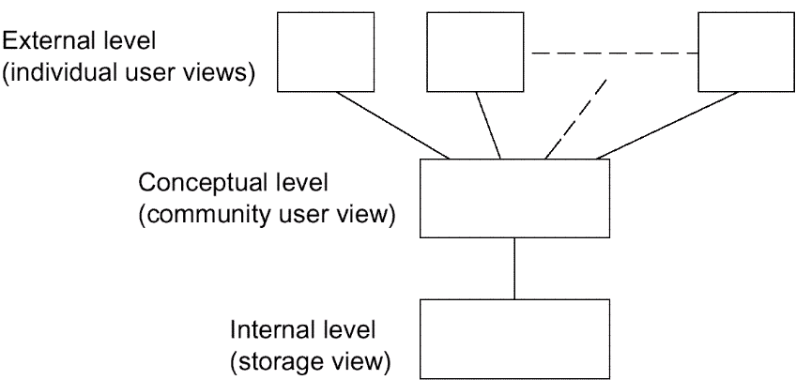
3. Database system architecture
----from DBMS
one
one
Fig. 2.1 The three levels of the architecture

Slide 7
The Three Levels of the Architecture
ANSI/SPARC
(1975) by American National Standard Institute - Standards Planning and requirements Committee(ANSI/SPARC)
internal level (Physical level) :
  the way the data is physically stored
external level (user logical level):
  the way the data is seen by individual users (application programmer or end user)
conceptual level (community logical level) :
  a level of indirection between the other two

Slide 8
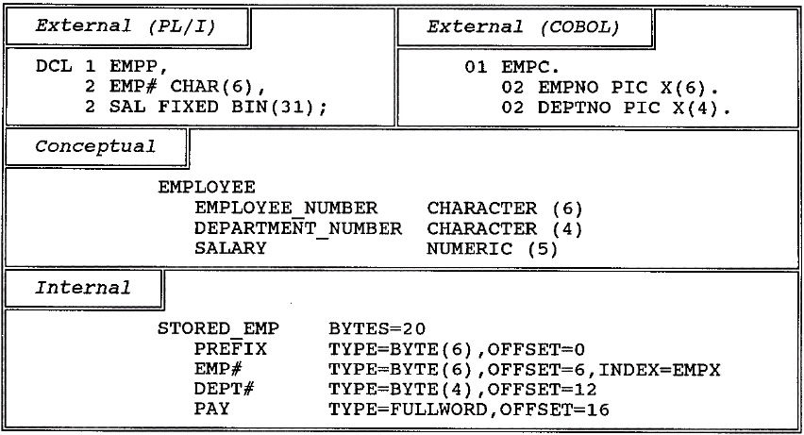
An example of the three levels
Fig. 2.2 An example of the three levels

Slide 9
Conceptual level
The conceptual view is a representation of the entire information content of the database.
The conceptual view is defined by means of the conceptual schema, which includes the definitions of each of the various conceptual records types
The "conceptual schema" is really little more than a simple union of all of the individual external schemas, plus certain security and integrity constraints.

Slide 10
E.g. conceptual schema of Database “Order”
  Table:
    Customer(Cno,Company,City,Tel)
    Order(Ono,Odate,Freight)
    Order_item(Ono,Pno,Quantity)
    Product(Pno,Pname,Price)
  integrity constraints
  security constraints
The conceptual schema is written using the conceptual DDL---just define information content

Slide 11
The External Level
External view is the individual user view.
User and language
  application programmer:
    programming language ,e.g., PL/I, C++, Java
    Proprietary language-4GLs
  end user:
    query language
    Special-purpose language (supported by application program)
all such languages include a data sublanguage,it include DDL and DML.

Slide 12
Data sublanguage (DSL)
Data Definition Language (DDL):supports the definition or declaration of database objects.
Data Manipulation Language (DML): supports the manipulation or processing of database objects.
Data sublanguage is embedded within the corresponding host language.
Data sublanguage is responsible for database operations, host language for non database facilities(e.g. user interface,data input and output, computational operations).
SQL
Tightly coupling ⬄loosely coupling
External view is defined by means of an external schema. It is written using the external DDL.

Slide 13
The Internal Level
The internal view is a low-level representation of the entire database.
internal view=storage structure or stored database
Internal level =physical level?
The internal view is described by means of the internal schema.
The internal schema is written using the internal DDL.
Application operates directly at internal level, recommended?

Slide 14
How the three levels of the architecture are typically realized in a relational system?
The conceptual level in such a system will definitely be relational:
  relational tables
  relational operators→result:table
A given external view will typically be relational:
  Table or View
the internal level will not be relational:
  stored records, pointers, indexes, hashes, etc.

Slide 15
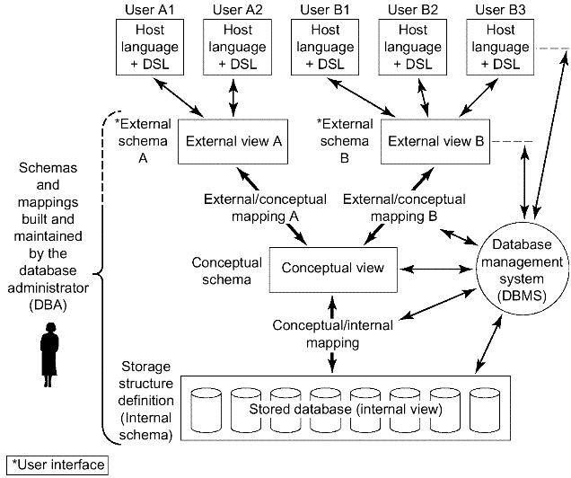
Detailed system architecture
Fig. 2.3 Detailed system architecture

Slide 16
Mappings
conceptual/internal mapping:
  Defines the correspondence between the conceptual view and the stored database;
  It specifies how conceptual records and fields are represented at the internal level.
  It is the key to physical data independence :If the structure of the stored database is changed ,the conceptual/internal mapping must be changed accordingly, so that the conceptual schema can remain invariant.

Slide 17
Mappings
external/conceptual mapping
  Defines the correspondence between a particular external view and the conceptual view.
  Fields can have different data types; field and record names can be changed; several conceptual fields can be combined into a single (virtual) external field;
  Any number of external views can exist at the same time;
  Any number of users can share a given external view;
  Different external views can overlap;
  It is the key to logical data independence.

Slide 18
Mappings
external/external mapping
Most systems support external/external mapping, rather than always requiring an explicit definition of the mapping to the conceptual level.

Slide 19
Mapping and Data Independence
data independence: the ability to modify a schema definition in one level without affecting a schema definition in the next higher level
Logical data independence: the capacity to change the conceptual schema without having to change external schemas or application programs.
Physical data independence: the capacity to change the internal schema without having to change the conceptual (or external) schemas.
The mapping of three-schema architecture can make it easier to have true data independence.

Slide 20
. Database system architecture(continued)
----from end users
single user
主从
Client/Server Architecture
Distributed Processing

Slide 21
Single user
The whole database system, including application, DBMS and data is in one computer, used by just one user. No data share

Slide 22
主从式结构
一个主机带多个终端
application, DBMS,data 放在主机上 所有处理任务有主机完成
各个用户通过主机的终端并发地存取数据库，共享数据资源
优点：
简单 数据易于管理和维护
缺点：
终端用户数目增加到一定程度，主机任务会过分繁重，成为瓶颈，系统性能大幅度下降
系统可靠性不高

Slide 23
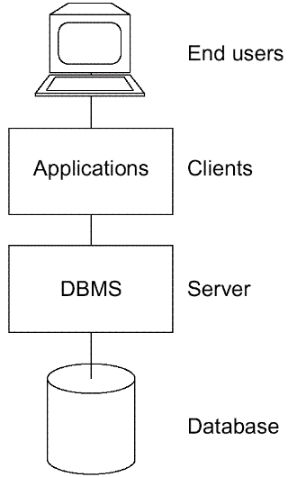
Client/Server Architecture
Server:
supports all of the basic DBMS functions.
Client:
the various applications that run on top of the DBMS—both user-written applications and built-in applications, i.e., applications provided by the DBMS vendor or by some third party.
Fig. 2.5 Client/server architecture

Slide 24
Client/Server Architecture(Cont.)
User-written applications:
  regular application programs
  written in C ,COBOL ,Java,…
Vendor-provided applications(tools):
  assist in the creation and execution of other applications
  E.g. report writer:
    allow user to obtain formatted reports through report writer language.

Slide 25
Vendor-provided tools
  Query language processors;
  Report writers;
  Business graphics subsystems;
  Spreadsheets;
  Natural language processors;
  Statistical packages;
  Copy management or "data extract" tools;
  Application generators (including 4GL processors);
  Other application development tools, including computer-aided software engineering (CASE) products;

Slide 26
Utilities
are programs designed to help the DBA with various administration tasks
--operate at the external level, perhaps provided by some third party
--operate at the internal level, provided by DBMS vendor
Load routines
Unload/reload routines
Reorganization routines
Statistical routines
Analysis routines

Slide 27
Benefit
Server (database) and client (application) processing are being done in parallel. Response time and throughput should thus be improved.
The server machine might be a custom-built machine that is tailored to the DBMS function (a "database machine") and might thus provide better DBMS performance.
The client machine might be a personal workstation, tailored to the needs of the end user and thus able to provide better interfaces, faster responses, and overall improved ease of use to the user.

Slide 28
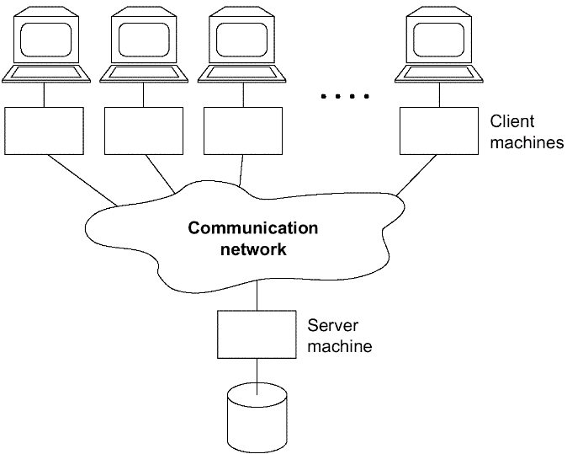
Benefit(continued)
Several different client machines might be able (in fact, typically will be able) to access the same server machine. Thus, a single database might be shared across several distinct client systems
Fig. 2.7 one server machine, many client machines

Slide 29
优点
减少了网络上的数据传输量，提高了系统的性能、吞吐量和负载能力
数据库更加开放。
客户机和服务器能在多种不同的硬件和软件平台上运行，可使用不同厂商的数据库应用开发工具，应用程序具有更强的可移植性，可减少软件维护开销
缺点
网络中有一台数据库服务器时，为众多的客户服务，容易成为瓶颈，制约系统性能
有多台数据库服务器时，数据处理、管理与维护有困难。

Slide 30
distributed database system
The client might be able to access many servers simultaneously (i.e., a single database request might be able to combine data from several servers). In this case, the servers look to the client—from a logical point of view—as if they were really a single server, and the user does not have to know which machines hold which pieces of data.
优点：
适应了地理上分散的组织对于数据库应用的需求
缺点：
数据分布存放给数据的处理、管理与维护带来了困难
系统效率会受到网络交通的制约

Slide 31
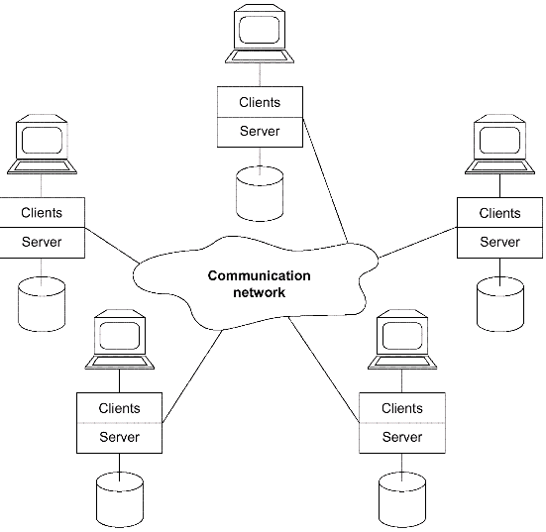
Each machine runs both client (s) and server
Fig. 2.8 Each machine runs both client (s) and server

Slide 32
4.The Database Administrator
DA(data administrator) is the person who makes the strategic and policy decisions regarding the data of the enterprise.
DBA is the person who provides the necessary technical support for implementing those decisions.

Slide 33
Tasks of DBA
Defining the conceptual schema(using conceptual DDL)
  DA :decide the content of the database at an abstract level (Logical DB design)
  DBA create the corresponding conceptual schema
  object form and source form of schema
  SQL: create table
Defining the internal schema (using internal DDL)
  The DBA must also decide how the data is to be represented in the stored database (physical database design).
  DBA create the corresponding internal schema
  Define the associated mapping
  Internal schema and mapping exists in both object and source form
Liaising with users
  Liaise with users to ensure that the data they need is available.
  Consulting on application design, providing technical education ,assisting with problem determination an resolution.
  write the necessary external schemas and the corresponding external/conceptual mappings using external DDL .(SQL: create view)
  external schema and mapping exists in both object and source form

Slide 34
Tasks of DBA
Defining security and integrity constraints
Defining dump and reload policies
  DBA define and implement an damage control scheme involving
    Periodic unloading or dumping of the database to backup storage
    Reloading the database when necessary from the most recent dump
Monitoring performance and responding to changing requirements

Slide 35
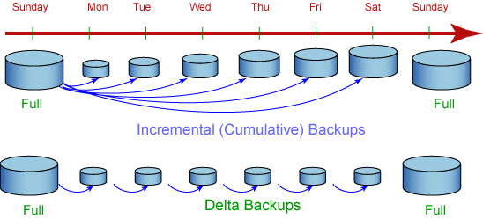
数据转储(备份)
增量：DB2 备份自上次完全数据库备份以来所更改的所有数据。
delta：DB2 将只备份自上一次成功的完全、增量或差异备份以来所更改的数据。
如果星期五进行增量备份之后发生崩溃，那么可以先恢复第一个星期日的完全备份，然后恢复星期五进行的增量备份。
如果星期五进行 delta 备份之后发生崩溃，那么可以先恢复第一个星期日的完全备份，然后恢复从星期一到星期五（包括星期五）所进行的每次 delta 备份。

Slide 36
5. DBMS
Database management system (DBMS) is the software that handles all access to the database.
  A user issues an access request, using some particular data sublanguage (typically SQL).
  The DBMS intercepts that request and analyzes it.
  The DBMS inspects the external schema for that user, the corresponding external /conceptual mapping, the conceptual schema, the conceptual/internal mapping, and the storage structure definition.
  The DBMS executes the necessary operations on the stored database.

Slide 37
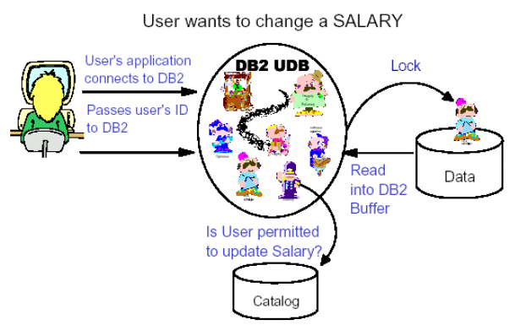
How DB2 Handles an SQL “Change” Request

Slide 38
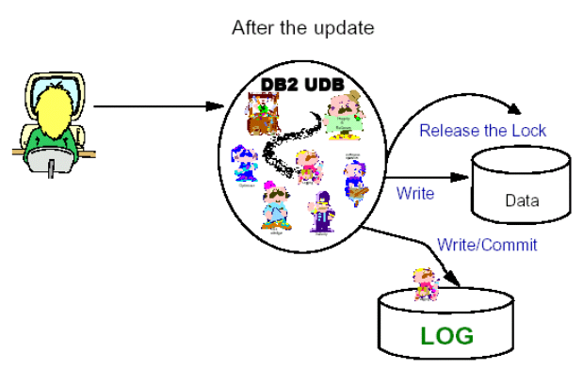
Finish the change request

Slide 39
Functions of DBMS
Data definitions
DBMS can
  accept data definition (external schemas,the conceptual schema,the internal schema and all associated mappings) in source form.
  Convert source form schema to the appropriate object form.
  Include DDL processor or DDL compiler

Slide 40
Functions of DBMS (Continued)
Data manipulation
DBMS can
  handle requests to retrieve, update, delete ,insert data to the database
  Include DML processor or DML compiler
  DML requests can be
    planned request: issued from prewritten application
    Characteristic of operational or production applications
    unplanned request: issued interactively via some query language processor.
    Characteristic of decision support applications

Slide 41
Functions of DBMS (Continued)
Optimization and execution
  optimizer, run-time manager
Data security and integrity
Data recovery and concurrency
  DBMS and other relative software are called transaction manager or transaction processing monitor
Data dictionary
data about data—metadata
store various schemas , mappings, security and integrity constraints in both source and object form.
Performance: efficiently

Slide 42
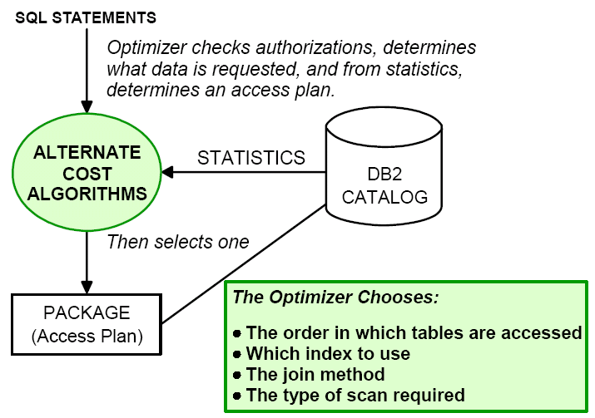
Functions of DBMS (Continued)
Optimization and execution

Slide 43
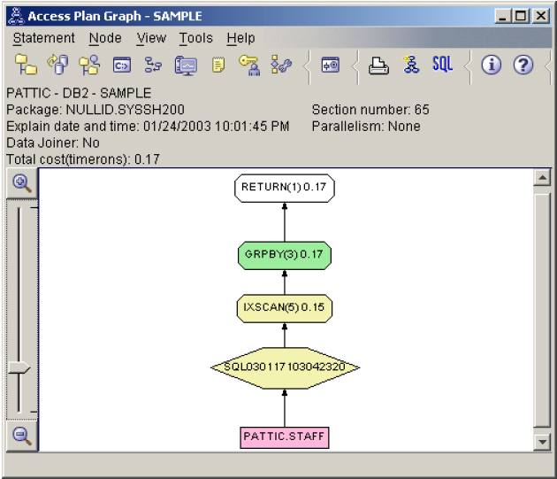
Functions of DBMS (Continued)
Access Plan

Slide 44
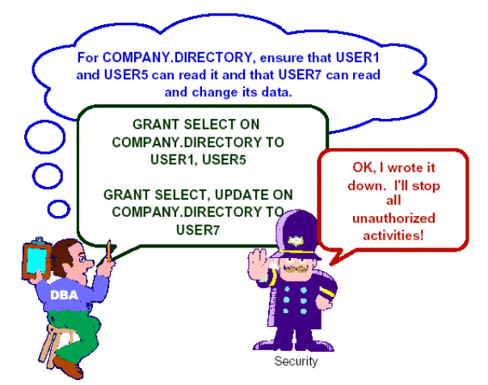
Functions of DBMS (Continued)
Security

Slide 45
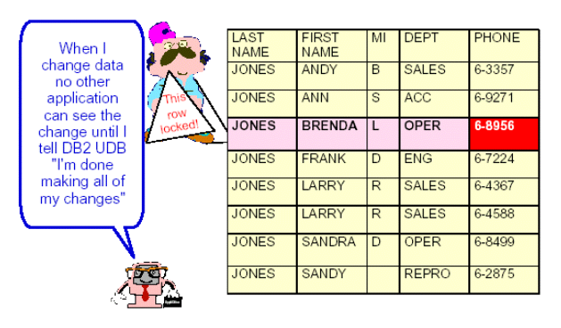
Functions of DBMS (Continued)
Integrity

Slide 46
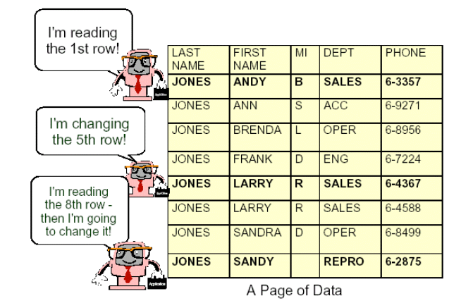
Functions of DBMS (Continued)
Concurrency

Slide 47
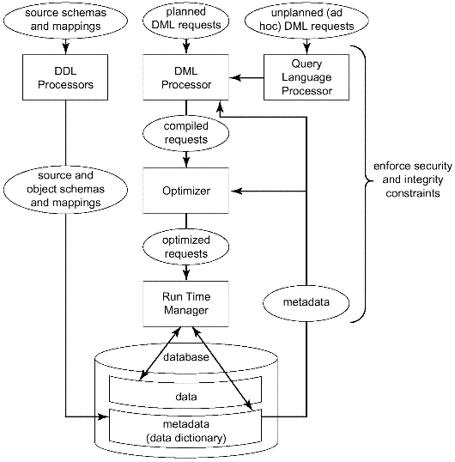
Data definition
Data manipulation
Optimization and execution
Data security and integrity
Data recovery and concurrency
Data dictionary
The overall purpose of DBMS is to provide the user interface to DB.
Which level?
Fig. 2.4 Major DBMS functions and components

Slide 48
DBMS & File management system(FMS)
FMS is the component of the underlying operation system that manages stored files----closer to the disk than the DBMS is.
DBMS is built on top of some kind of FMS
Users of FMS can create and destroy stored files and perform simple retrieval and update operations on stored records in such files

Slide 49
In contrast to DBMS…. FMS
Are not aware of the internal structure of stored records and can not handle requests that rely on a knowledge of that structure
Provide little or no support for security and integrity constraints.
Provide little or no support for recovery and concurrency constraints
No dictionary concept
Provide much less data independence
Files are not integrated or shared in the same sense that DB is

